Slide 1
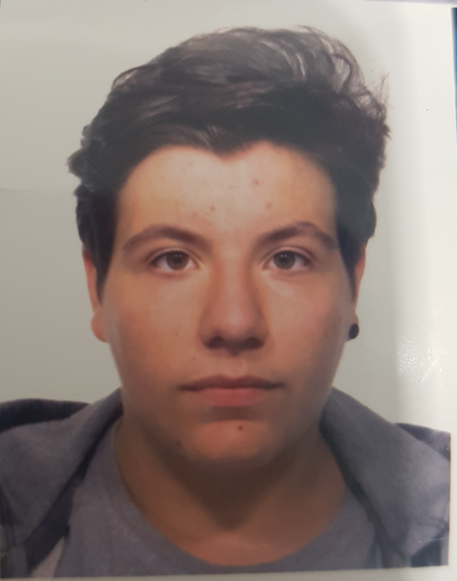



Simone Marchetta
PERSONAL
INFORMATION
AND HOBBIES
Born in Genova on the 18 Dicembre 2000.
Nationality: Italian.
Marital status: unmarried.
Driver’s license: A1.
HOBBIES:
In my freetime I like going out with my friends and listening to the music.
Also, I collect lighters and I really like play videogames.
But my favorite thing is to go to the stadium to see Sampdoria.
VIA JACOPO BONFADIO 10/1
EXPERIENCES
LIGURIA DIGITALE| 2017 – 2018 | GENOVA
Liguria Digitale develops the digital strategy of the Liguria Region for citiziens, businesses, tourists and the Ligurian public administration.
It creates innovative and technologically advanced projects, to provide all digital services and information easily accessible.
It also promotes Liguria in the world through digital communication and marketing campaigns developed and managed for our customers and partners.
3423879736
simone.marchetta.iic00@gmail.com
INFORMATIC COMPETENCES
SCHOOLING
Programming in C
Programming in Java
Programming in HTML
ELEMENTARY SCHOOL | Giosué Carducci | 2006-11 | Genova
SECONDARY SCHOOL |Virginia Centurione | 2011-14 | Genova
HIGH SCHOOL |Italo Calvino | 2014-? | Genova
I’m still attending Italo Calvino State Technical Institute, I’m at the penultimate year. My school is divided into an informatic and a scientific address. I have chosed the computer address, because I am a computer enthusiast.
LANGUAGES
English
French
Italian

